Slide 1


Design and Evaluation Frameworks for Advanced RISC-based Ternary Processor
D. Kam, J. G. Min, J. Yoon, S. Kim, S. Kang and Y. Lee
Department of Electrical Engineering
Pohang University of Science and Technology (POSTECH), South Korea
Notes:
Good afternoon. Thank you for attendance. My name is dongyun Kam from POSTECH, south korea.
I am going to talk about the design and evaluation frameworks for ternary processor.

Slide 2

Biography
Dongyun Kam
Ph.D. student
Department of Electrical Engineering
Pohang University of Science and Technology (POSTECH)
South Korea
Interesting topics
5G/B5G wireless communication systems
Error correcting codes
VLSI circuit designs
Ternary processors
RISC-V processors
Email address
rkaehddbs@postech.ac.kr
Personal information:
https://sites.google.com/view/epiclab/member/dykam?authuser=0
Notes:
This is my biography.
I received B.S and M.S degree and now I am working for Ph.D degree in POSTECH south korea.
My current research topics are Algorithm for error correcting codes of 5G and beyond communications.
And, I am interested in hardware architecture and VLSI circuit, ASIC-level design.
Recently I have studied ternary processors and RISC-V processors, which are topics in this presentation.

Slide 3
Outline
Introduction
Ternary number systems and operators
Proposed frameworks for ternary processors
Proposed ART-9 core design
Simulation results
Conclusion
Notes:
This is a presentation outline
First of all, I’ll introduce motivation and fundamentals for ternary systems.
And then present a new frameworks and design for ternary processors.
Finally, we report the simulation results with the proposed frameworks and design.

Slide 4
Outline
Introduction
Ternary number systems and operators
Proposed frameworks for ternary processors
Proposed ART-9 core design
Simulation results
Conclusion
Notes:
Let me start with introduction

Slide 5
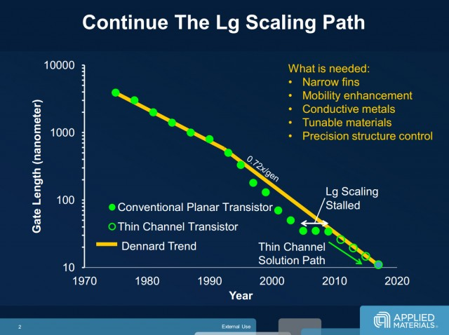
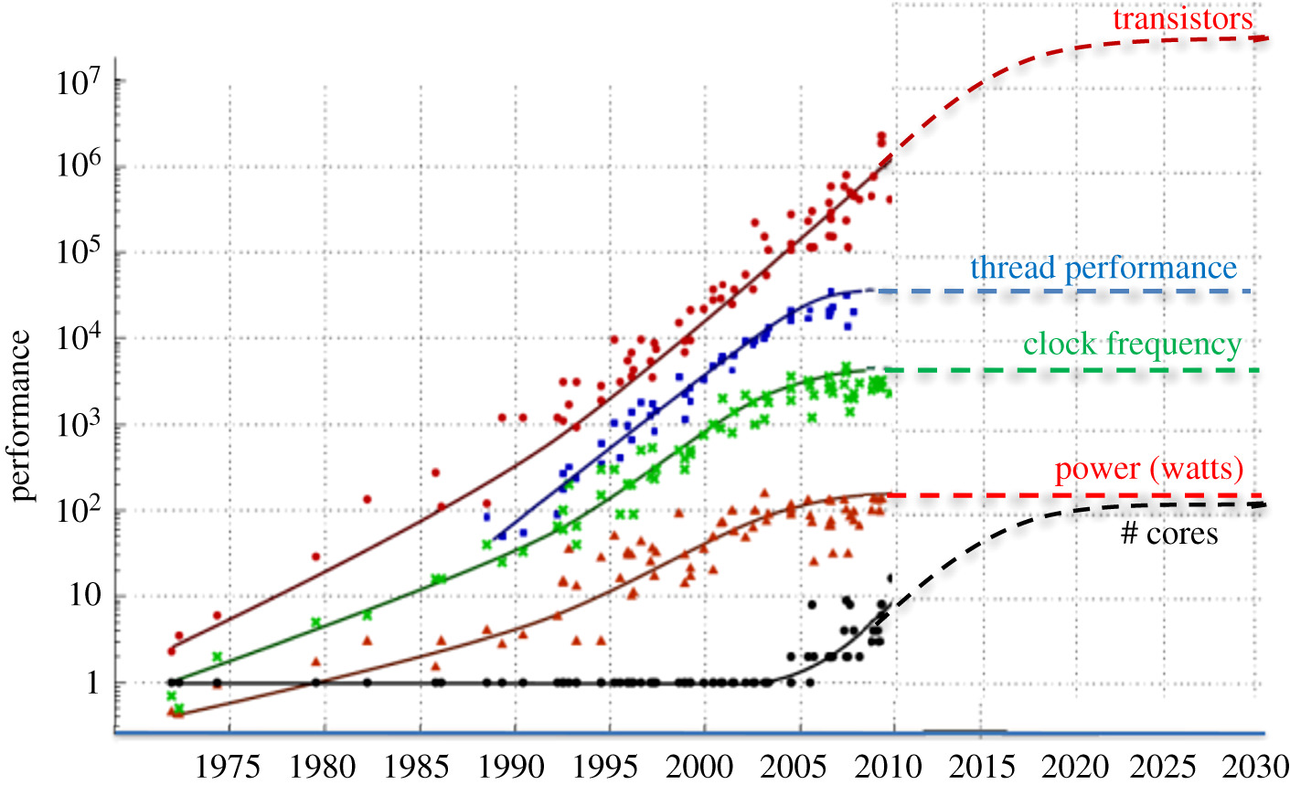
Introduction
Downscaling digital circuits met limitation
Limitation caused by increased interconnecting/routing overhead
Fig.1. Down-scaling of CMOS technology [R1]
Fig.2. Change of the CPU perfoamcnes [R2]
[R1] https://www.extremetech.com/computing/162376-7nm-5nm-3nm-the-new-materials-and-transistors-that-will-take-us-to-the-limits-of-moores-law
[R2] https://royalsocietypublishing.org/doi/10.1098/rsta.2019.0061
Notes:
So for, we have tried reducing transistor size in order to improve implementation efficiency.
However, the performance improvement met the potential limitation by interconnection overheads, which are from many small transistors.
So, as shown in Ffig.2, we can predict the performance is saturated in the near future.

Slide 6
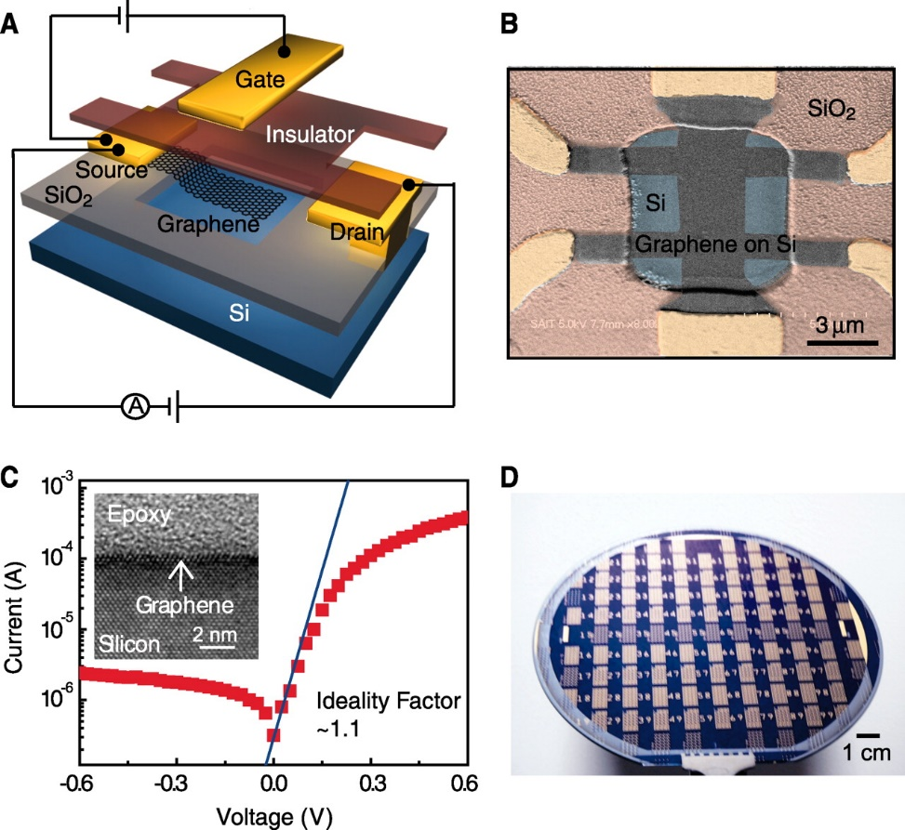
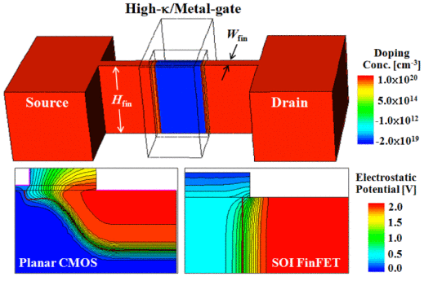
Introduction
Multi-valued logic (MVL) circuits & Ternary processor
MVL based circuits can be the solution of addressing limitation
Fig.3. Graphene barristors [R1]
Fig.4. Carbon nanotube field-effect transistor (CNTFET) [R2]
[R1] H. Yang et al., Science, 2012
[R2] S. Lin et al., IEEE MWSCAS,2009.
Notes:
To address this performance saturation, many works have studied multi-valued logic (MVL) circuits such as Graphene barristors and CNTFET.
Based on these MVL, we can reduce the number of gates and then also reduce circuit-level complexity and routing overhead
Among these MVL devices, ternary-based systems are considered as the starting point of MVL solutions.
In this work, we will focus on ternary-based circuit and systems.
Specially, we are interesting in the ternary processor.

Slide 7
Outline
Introduction
Ternary number systems and operations
Proposed frameworks for ternary processors
Proposed ART-9 core design
Simulation results
Conclusion
Notes:
To design a ternary processor, we should understand fundamentals for ternary number systems and operations.

Slide 8
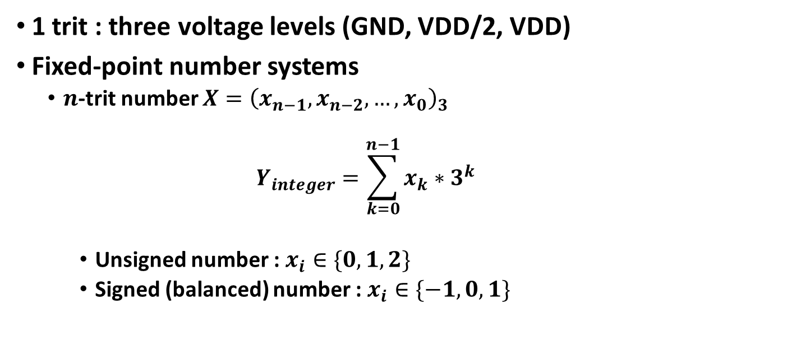
Ternary Number Systems
1 trit : three voltage levels (GND, VDD/2, VDD)
Fixed-point number systems
$n$-trit number $X={\left(x_{n−1},x_{n−2},…,x_{0}\right)}_{3}$
$$Y_{integer}=\sum_{k=0}^{n−1}{x_{k}{∗3}^{k}}$$
Unsigned number : $x_{i}∈\{0,1,2\}$
Signed (balanced) number : $x_{i}∈\{−1,0,1\}$
Notes:
In ternary number systems, we utilize trit which is similar to bit in binary systems
1-trit value can have three state; GND, VDD/2, VDD.
With multiple trit values, we can construct the fixed-point number system.
For example, the trit sequence X is denoted as this and its magnitude equals to integer Y value from this summation
In unsigned number system, each trit can be 0,1 or 2 while In balanced number system, each trit has -1,0,1 value for simple representation of negative values.

Slide 9
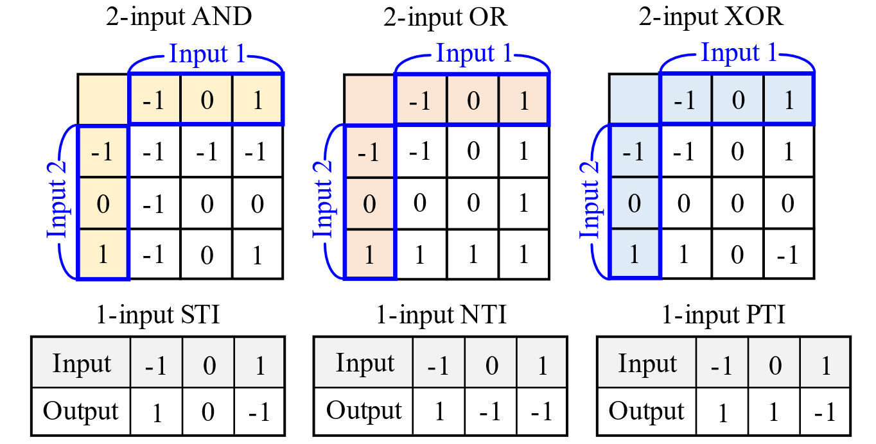
Ternary Operators
Ternary-based logical operations
Based on balanced number system
Fig. 1. Truth tables of ternary logic operations
Notes:
Based on the balanced numbers, we can define logical operations with 1-trit outputs.
Similar to binary operators, there are basic AND, OR, XOR and new three inverting operations STI, NTI, PTI.

Slide 10
Ternary Operators
Ternary-based arithmetic operations
Based on RISC-based binary processors
The existing arithmetic operators
Ternary adder [R1]
Ternary comparator [R2]
Ternary divider [R2]
Ternary multiplier [R3]
[R1] S. Heo et al. IEEE Electron Device Lett., 2018.
[R2] B. Parhami et al., ACSSC, 2013.
[R3] Y. Kang et al, IEEE ISMVL, 2017.
Notes:
In addition, many works have developed efficient ternary arithmetic operators for the future ternary processors
There are adder, comparator, divider and multipliers
From these logical and arithmetic operators, we can study processor-level ternary design

Slide 11
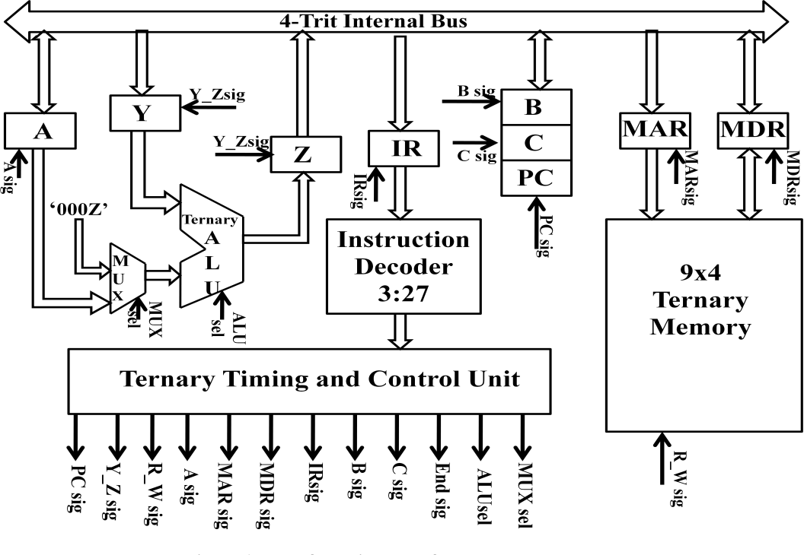
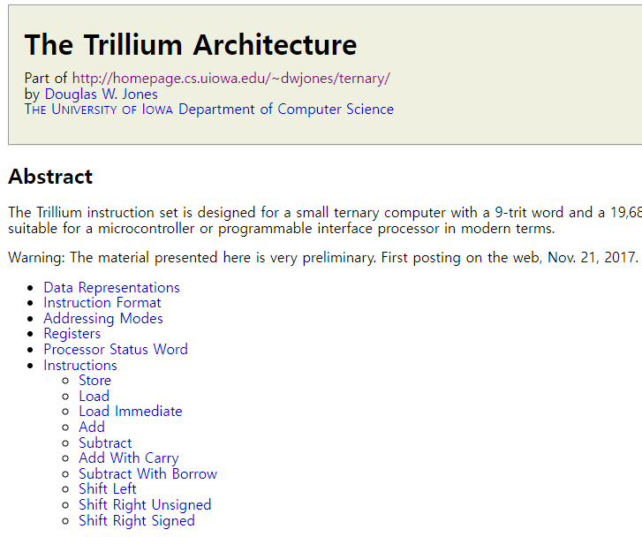
Previous Works
Existing ternary processors
CISC-based 4-trit processor (Fig. 5)
RISC-based 9-trit processor (Fig. 6)
Fig. 5. CISC-based 4-trit processor [R1]
Fig.6. RISC-based 9-trit ternary processor [R2]
[R1] S. Narkhede et al., IJCA, 2013
[R2]https://homepage.divms.uiowa.edu/~jones/ternary/trillium.shtm
Notes:
There are only few works about ternary processors.
Here, I introduce two recent ternary processors.
In Fig.5, the first one is CISC-based design for 4-trit data path, which has many instructions.
And in Fig. 6, second processor is RISC-based design for 9-trit data path and it supports the basic ternary operations.
However, there are several problems.

Slide 12
Limitation of Previous Works
Lack of open-literature
Only few papers for ternary processors.
Not considering the technology-level design
Previous ternary processors are just designed for functionality.
Inefficient ternary processor
CISC-based ternary processor
Inefficient instructions and architecture
Notes:
As I emphasized just second ago, there is a extreme lack of studies on the ternary processor Maybe this topic has recently gotten attentions.
Even few papers are not realistic because they only considered the functionality by ignoring the technology-level design.
Moreover, both of CISC-based and RISC-based processors have too many instruction for their small-size date path
So, they would be implemented inefficiently for practical applications.

Slide 13
What we propose
Frameworks to design and evaluate ternary processors
Software-level compiling framework
Hardware-level evaluation frameworks
Advanced RISC-based ternary 9-trit processor (ART-9)
Optimized instruction set architecture (ISA)
5-stage pipelined core architecture
Notes:
We tried to address these limitations.
In this work, we firstly propose frameworks for designing ternary processors, considering technology and practical implementation.
The proposed frameworks include software-level compiling framework and hardware-level evaluation frameworks.
And then, we also propose new ternary processor design (ART-9), which is 9-trit advanced RISC-based ternary processor.
The processor design is detailed in terms of the optimized ISA and pipelined core architecture.

Slide 14
Outline
Introduction
Ternary number systems and operators
Proposed frameworks for ternary processors
Proposed ART-9 core design
Simulation results
Conclusion
Notes:
From now, I will explain our contributions.
Let me start with proposed frameworks.

Slide 15
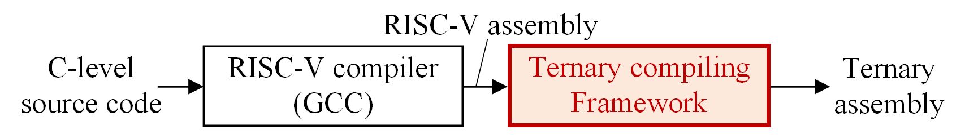
Proposed Frameworks
Software-level compiling framework
Given ternary-based ISA
Converting C-level codes into ternary assembly
Adopting RV-32I ISA and the existing GCC [R1]
Fig.7. Overall procedure of the proposed softwre-level framework
[R1] G. Tagliavini et al., DATE, 2019
Notes:
Unlike previous works, we firstly present a software-level framework tool
Given ternary-based ISA, this overall framework converts C-level codes into ternary assembly.
We utilize RV-32I ISA and the existing compiler GCC.
After GCC makes RISC-V assembly, the proposed ternary compiling framework start to convert the RISC-V assembly into ternary assembly.

Slide 16
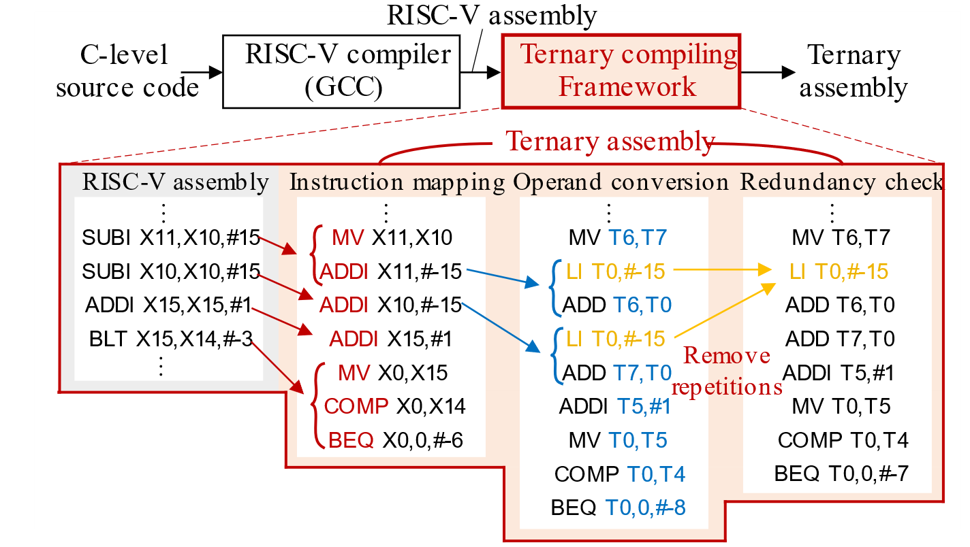
Proposed Frameworks
Software-level compiling framework
Three compiling steps
Instruction mapping, operand conversion, redundancy check
Fig.8. Proposed software-level compiling framework
Notes:
This figure shows a detail procedure of ternary compiling framework
This framework has three steps; instruction mapping operand conversion redundancy check.

Slide 17
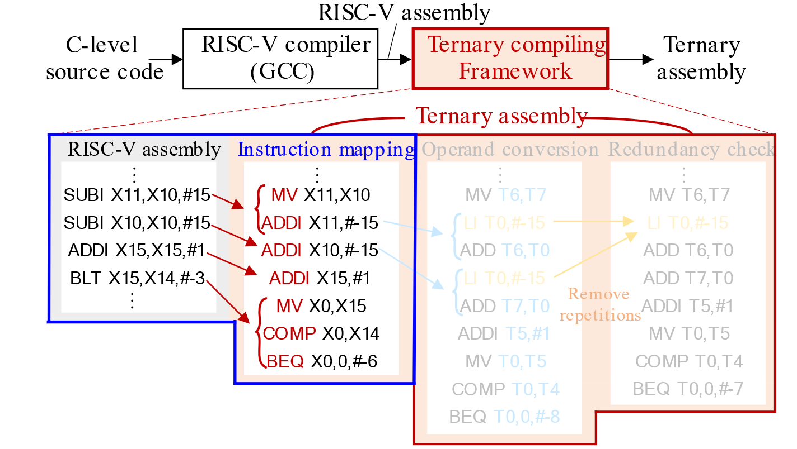
Proposed Frameworks
Software-level compiling framework
Instruction mapping
Fig.9. Instruction mapping step in the proposed framework
Notes:
First step is instruction mapping.
The instruction mapping step is activated to translate 32-bit instructions into pre-defined ternary instructions.
If a binary instructions cannot be directly converted with one ternary instruction, we can several ternary instructions.
For example in this figure, the SUBI has two operand and one destination, but ternary instruction only has two operand.
In this case, the SUBI is converted into two ternary instruction MV, ADDI.

Slide 18
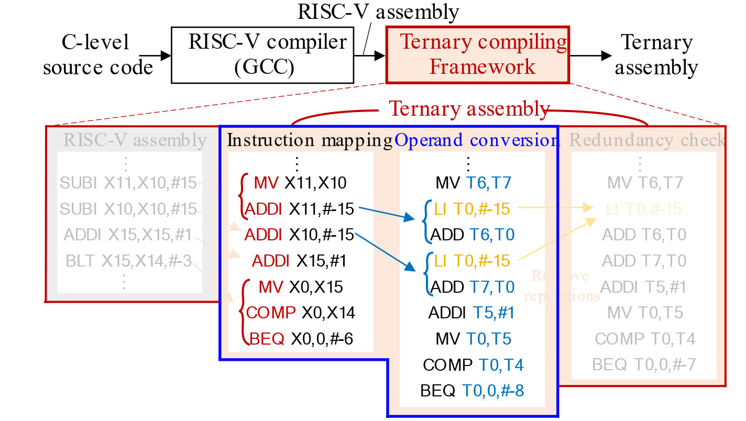
Proposed Frameworks
Software-level compiling framework
Operand conversion
Fig.10. Operand conversion step in the proposed framework
Notes:
After mapping ternary instruction, the operand conversion is activated to translate binary operands into ternary operands.
This step find ternary representations of immediate values in baseline binary instructions.
If the ternary ISA utilizes a short length for immediate values, we can put additional instructions to make the large binary operands as shown in Fig. 10.
This also support the register renaming when the given ternary ISA uses fewer general-purposed registers than binary processors.

Slide 19
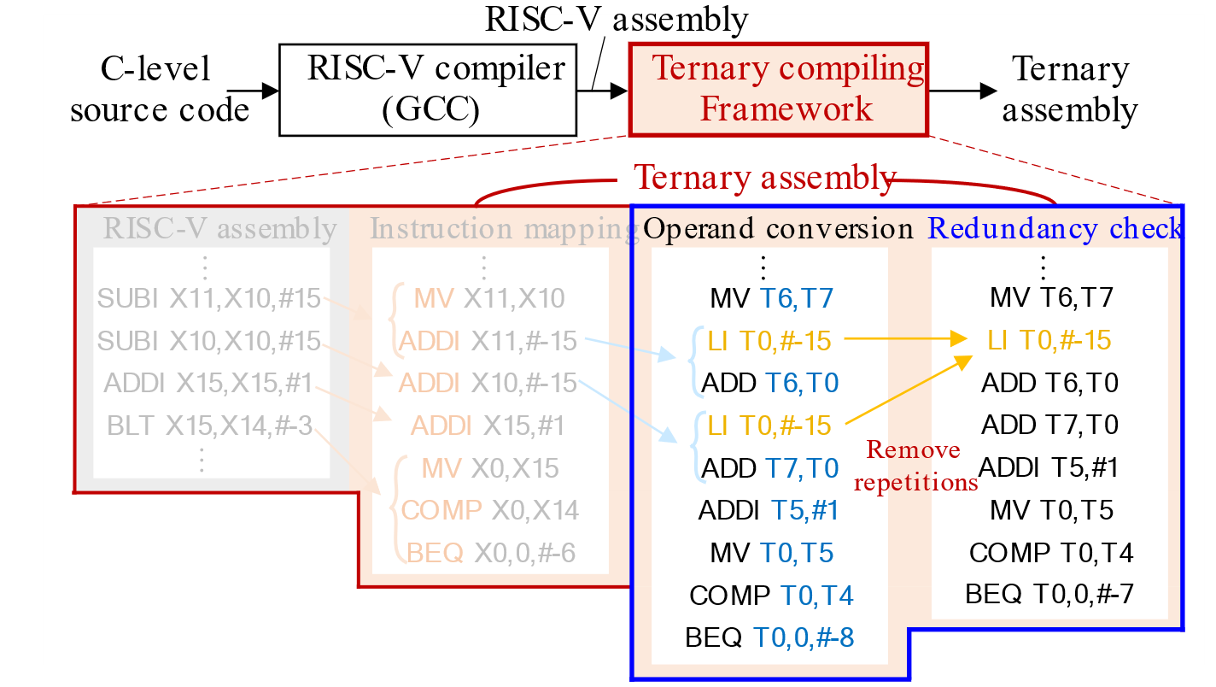
Proposed Frameworks
Software-level compiling framework
Redundancy check
Fig.11. Redundancy check in the proposed framework
Notes:
Finally, to optimize the number of instructions, redundancy check is required.
As the instruction mapping and operand conversion steps may use additional instructions, the redundancy check step finds the repeated or meaningless instructions and remove them.
From this, we can minimize the program size.

Slide 20
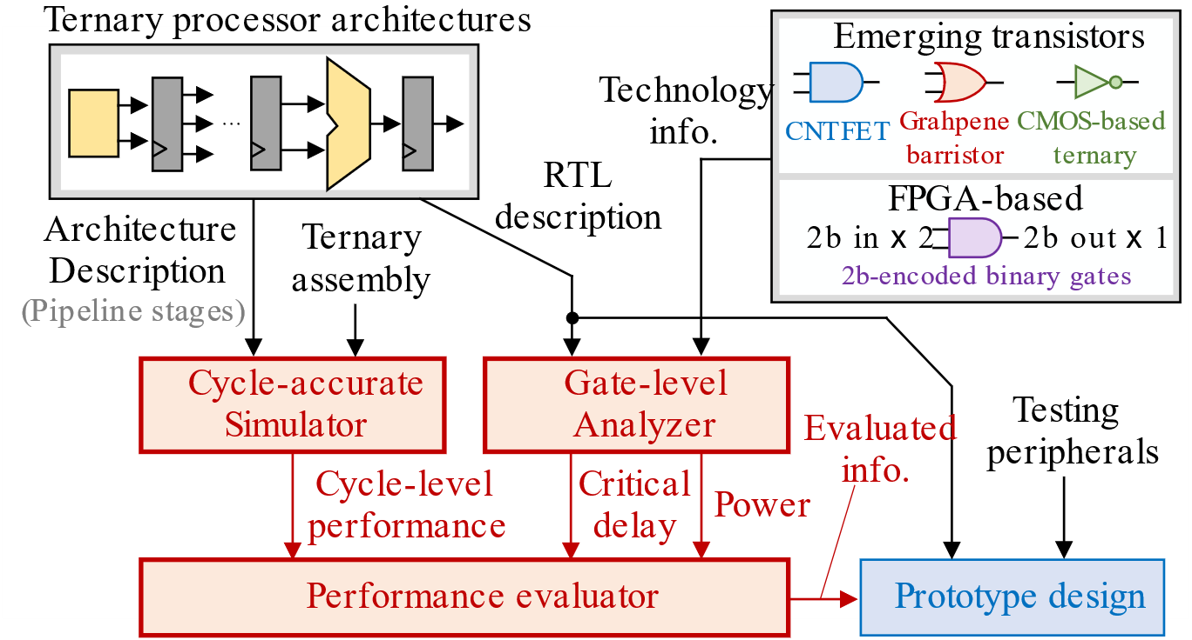
Proposed Frameworks
Hardware-level evaluation framework
Considering the practical implementation
Fig.12. Proposed hardware-level evaluation framework
Notes:
Next, Hardware-level evaluation framework.
Fig 12 shows the overall procedure of the proposed evaluation framework.
This consists of cycle-accurate simulator, gate-level analyzer and performance evaluator
The final prototype design is implemented with architecture description, ternary assembly and technology information.

Slide 21
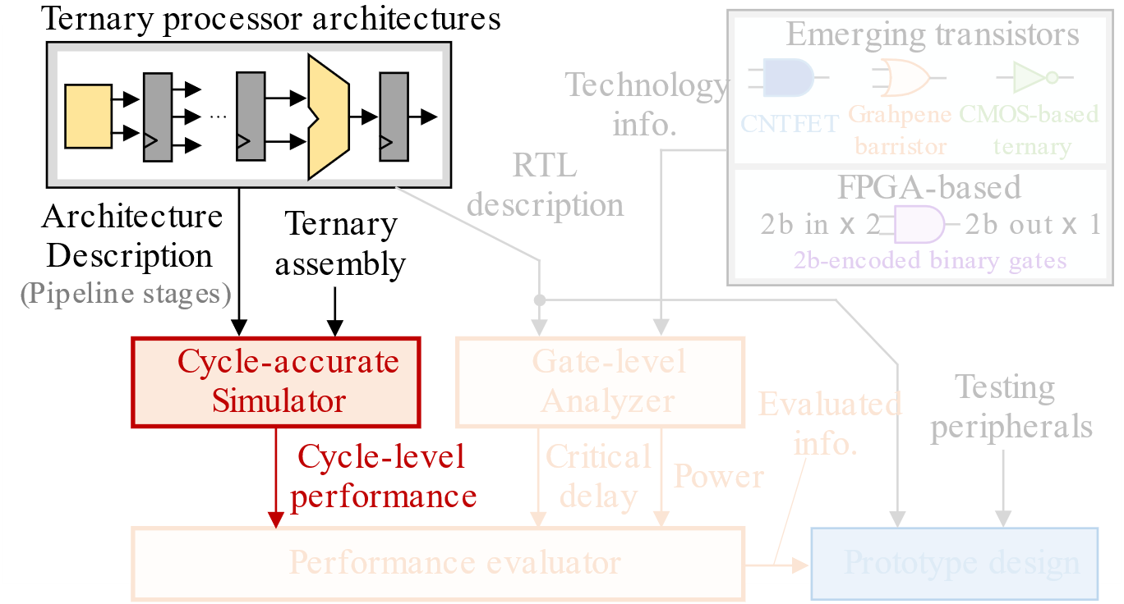
Proposed Frameworks
Hardware-level evaluation framework
Cycle-accurate simulator
Fig.13. Proposed cycle-accurate simulator
Notes:
In details, cycle-accurate simulator takes architecture description and ternary assembly.
This provides the required processing cycles to perform input ternary assembly codes.
And this framework can also simulate the behavior of the given ternary processor for the given assembly
Finally it calculate the number of cycles, even considering the data hazard and stall instructions.

Slide 22
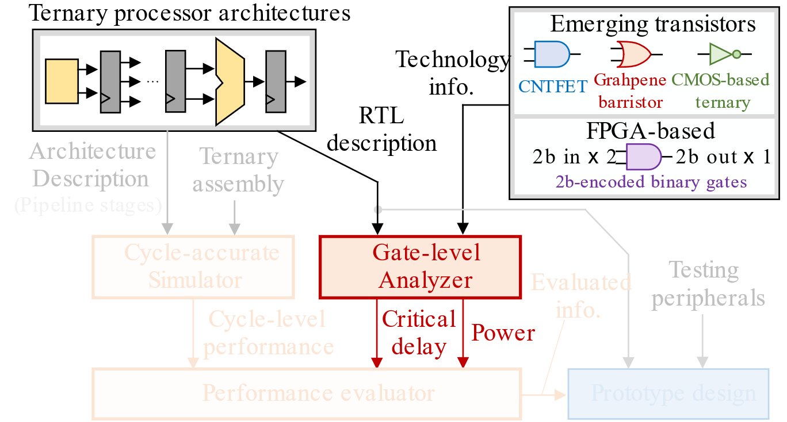
Proposed Frameworks
Hardware-level evaluation framework
Gate-level analyzer
Fig.14. Proposed gate-level analyzer using technology information
Notes:
With synthesizable RTl design and technology information,
the gate-level analyzer can estimate critical path delay as well as power consumption of the given ternary processor.
The technology information can be
CNTFET-based, Grahpene barrister CMOS-based ternary, or even 2b encoded gates.

Slide 23
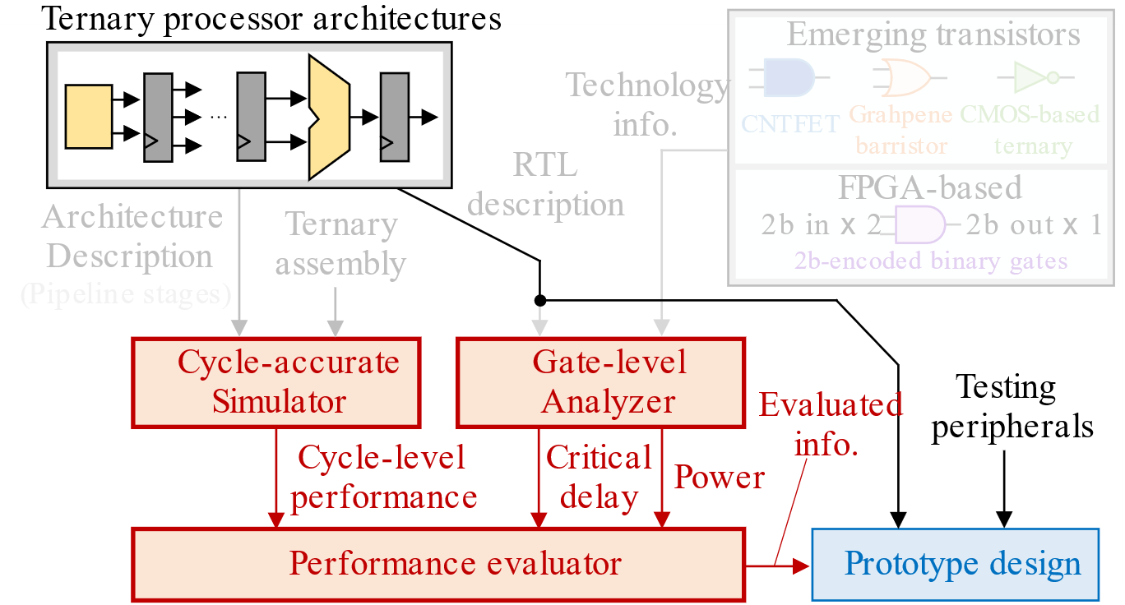
Proposed Frameworks
Hardware-level evaluation framework
Total performance evaluator
Fig.15. Prototype design using performance evaluator
Notes:
The performance evaluator gathers all the outputs form prior steps, and finally generates overall evaluation information of the ternary processor
If we have various design options, we can find an optimal design by using the estimated values.

Slide 24
Outline
Introduction
Ternary number systems and operators
Proposed frameworks for ternary processors
Proposed ART-9 core design
Simulation results
Conclusion
Notes:
This is second contribution
Let me introduce proposed ART-9 core design.

Slide 25
Proposed Processor Design
Advanced RISC-based ternary 9-trit processor (ART-9)
Properties of contempoaray RISC-type binary processors.
ART-9 instruction set architecture (ISA)
Pipelined core architecture
Notes:
Based on our frameworks, we develop a new ART-9 processor.
We adopt some properties of the recent light-weight RISC-type processor such as the small number of instructions.
ART-9 ISA is defined and then, we design pipelined core architecture for the proposed ART-9 ISA.

Slide 26
Proposed Processor Design
ART-9 ISA
9-trit length instructions
24 instructions
2-trit opcode
R-type, I-type, B-type, M-type
Ternary instruction memory (TIM)
9-trit length data
Ternary data memory (TDM)
Nine 9-trit length registers
General-purpose ternary register file (TRF)
Program counter (PC) register
Notes:
With 9-trit length, the ART-9 ISA only has 24 instructions by using 2-trit opcode.
We define four instruction types Register R, immediate I, Branch B, Memory M type.
In ternary program, we store these ternary instruction sequences in the dedicated ternary instruction memory (TIM)
The proposed ISA has the same data length to the instruction length and use separate data memory, TDM
And we also dedicate nine general purpose ternary register file (TRF) and one program counter register.

Slide 27
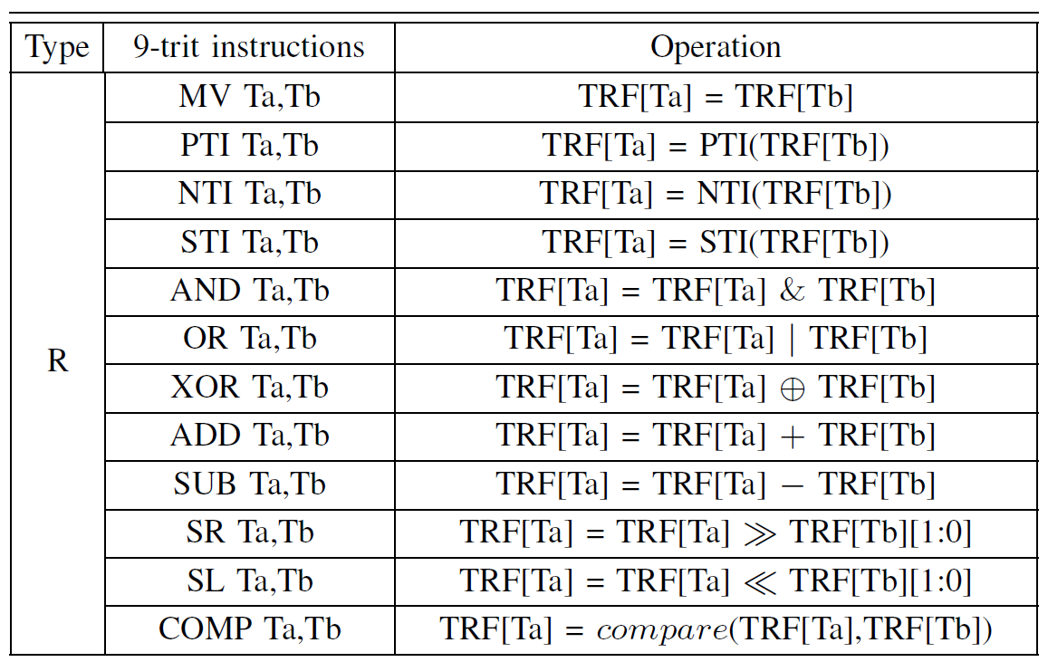
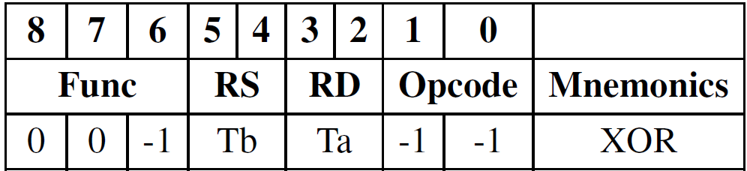
Proposed Processor Design
ART-9 ISA
9-trit length instructions
R-type (12 logical/arithmetic operations)
Register addressing
Two operands
XOR
R-type
Operand 1
address
Operand 2 & destination
address
Notes:
More precisely, the R-type instructions are defined to perform logical and arithmetic operations.
With the register addressing like this, these instructions access the TRF and take two operands.
As the short 9-trit length, the first address Ta is used as destination address to store the operation results.
To define twelve different instructions, we use 3-trits as func part.
Thus, we can use typical operations with MV, inverting, ADD, SUB, COMP instruction and so on.

Slide 28
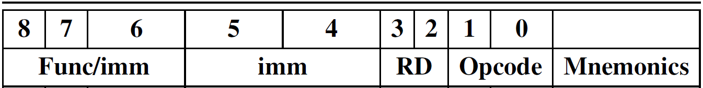
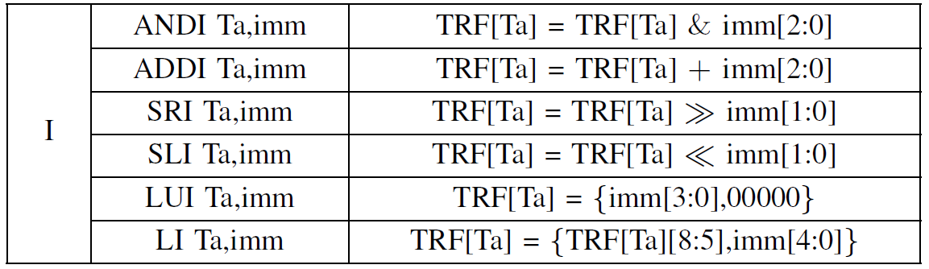
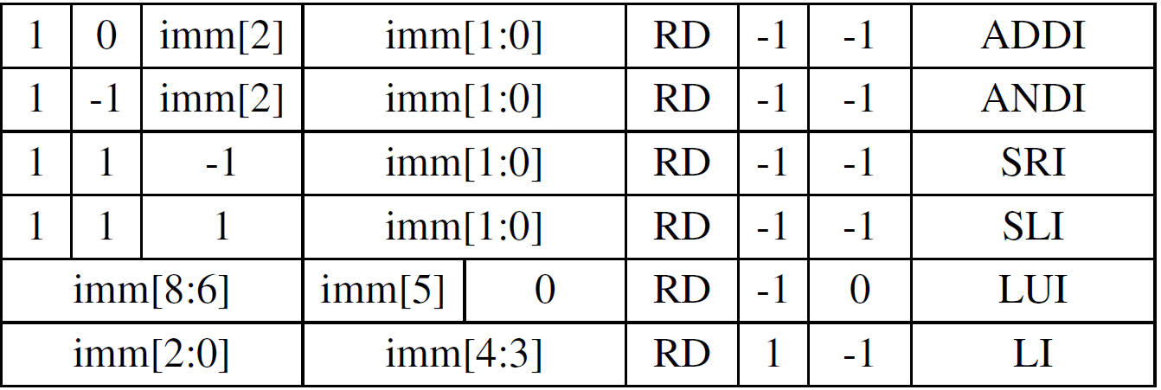
Proposed Processor Design
ART-9 ISA
9-trit length instructions
I-type (6 immediate-based processing)
Supporting 2~5-trit immediate values
Various imm length
I-type
Notes:
In order to reduce the generation complexity of constant values, the recent binary ISA encodes immediate values into the instruction directly.
Adopting this property of recent ISA, we define I type instructions to use direct immediate operands instead of the register addressing.
The proposed i-type instructions support different immediate lengths depending on instructions.
As a result, the ART-9 ISA offers an acceptable flexibility to use wide ranges of immediate values.

Slide 29
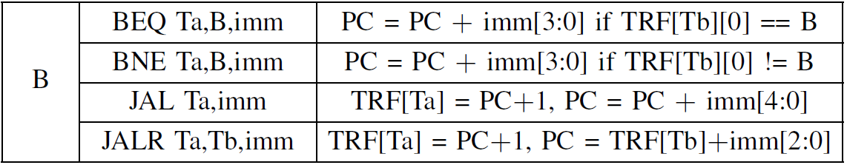
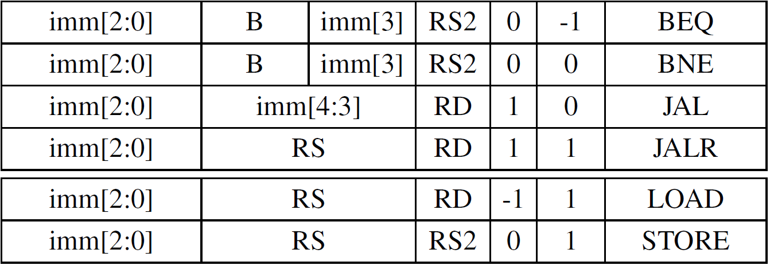
Proposed Processor Design
ART-9 ISA
9-trit length instructions
B-type (4 jump/branch instructions)
Calculating next PC values with an immediate
/
Various imm length
B-type
Notes:
Besides, it is also required to define B-type instructions, which change the PC value.
We introduce four instructions using the PC-relative addressing.
Two conditional branch instructions use 1-trit B value in BEQ and BNE, which compare B value and register operand to check the branch-taken.
Two unconditional jump instructions directly change PC values with immediate values.

Slide 30
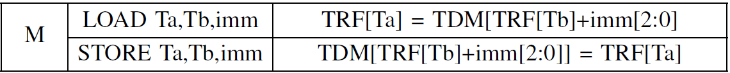
Proposed Processor Design
ART-9 ISA
9-trit length instructions
M-type (2 memory access instructions)
Harvard architecture (separate two memory; TIM/TDM)
TRF address
Notes:
We want to store operands in TDM and load them from TDM
For this, we define M-type instruction LOAD and STORE.

Slide 31
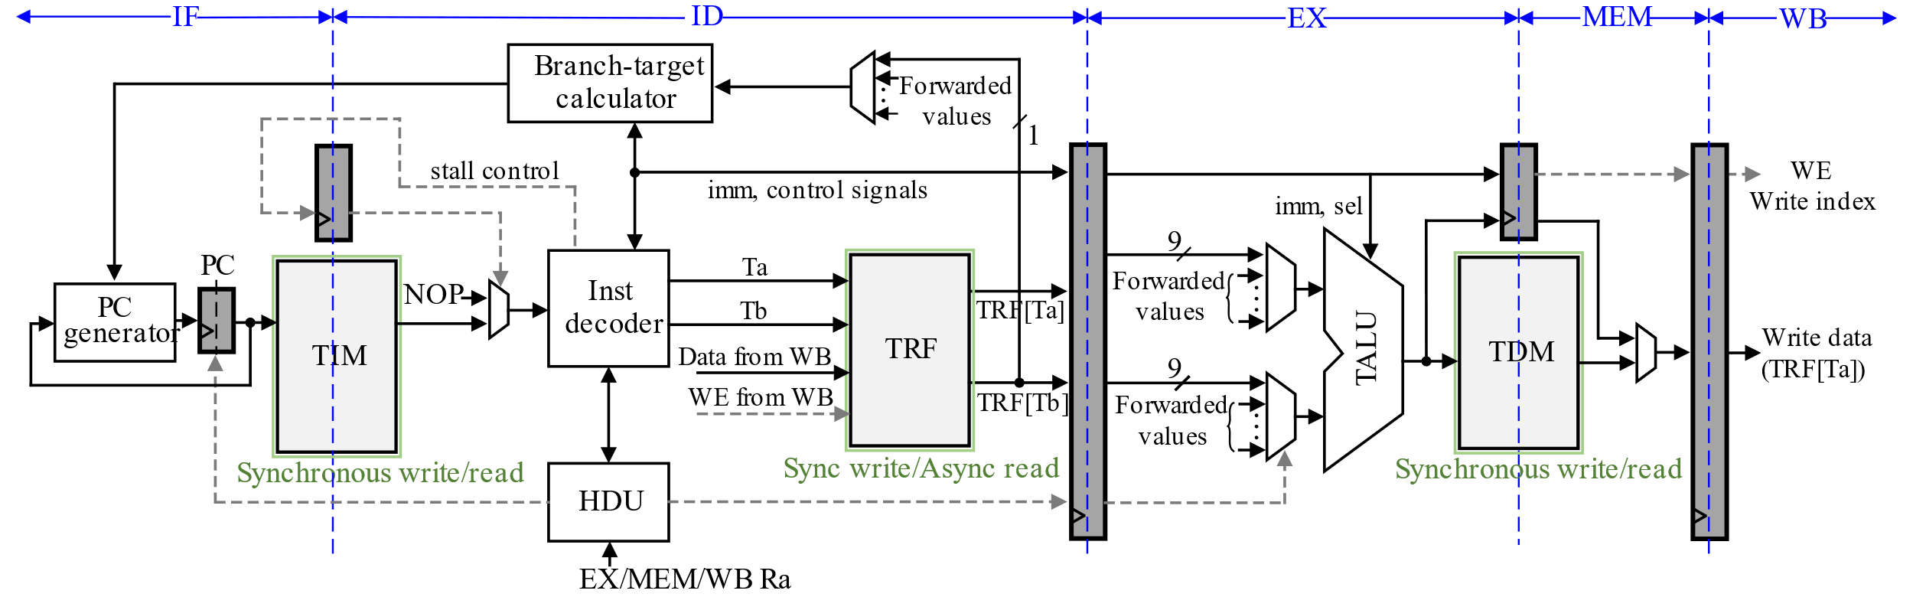
Proposed Processor Design
ART-9 core architecture
Similar to binary RISC-V architecture
5-stage pipelining
IF, ID, EX, MEM, WB
Fig.16. 5-stage pipelined ART-9 core architecture
Notes:
Now, we design pipelined ART_9 core architecture.
Fig. 16 shows the overall 5-stage architecture which includes instruction fetech (IF), instruction decoder (ID), execution (EX), memory access (MEM), and write back( WB)
This architecture is ternary processor version of the RISC-V architecture.

Slide 32
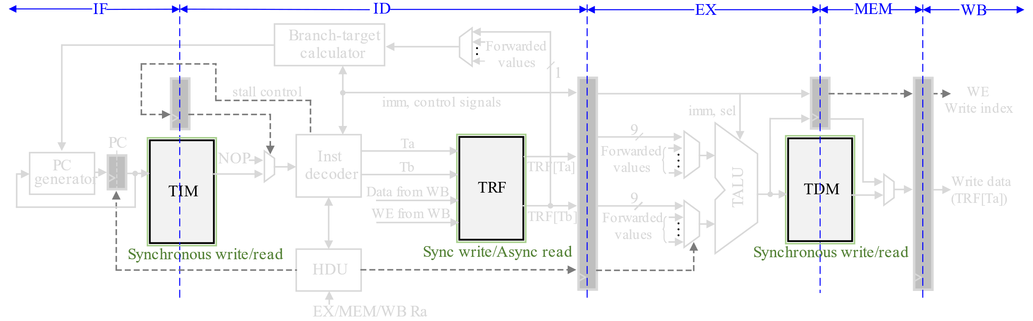
Proposed Processor Design
ART-9 core architecture
TIM/TDM :Synchronous write/read
TRF : Synchronous write / Asynchronous read
Fig.17. TIM, TRF and TDM for the proposed ART-9 processor
Notes:
To support the proposed ART-9 ISA, this processor should have separate TIM, TDM and TRF.
TIM/TDM perform synchronous write/read and TRF perform synchronous write and asynchronous read.

Slide 33
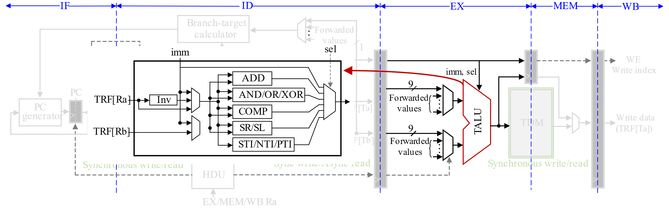
Proposed Processor Design
ART-9 core architecture
Ternary ALU
Supporting ART-9 ISA
Fig.18. TALU of the proposed ART-9 processor
Notes:
When a decoded instruction arrive at EX stage, the ternary ALU (TALU) is activated to calculate logical and arithmetic operations with two operands.

Slide 34
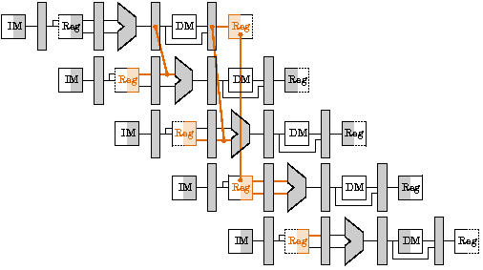
Proposed Processor Design
ART-9 core architecture
Minimizing stall instructions
Handling data/control hazards
Fig.19. Pipelined processing of binary RISC-V processor [R1]
[R1] https://www.cs.fsu.edu/~hawkes/cda3101lects/chap6
/index.html?$$$F6.37.html$$$
Notes:
As you can see, the pipelined architecture is efficient when it continuously perform instructions.
However, there are data and control hazards.
The hazard control is required to minimize the stall timing and improve the processor efficiency.

Slide 35
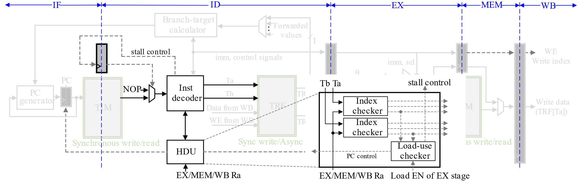
Proposed Processor Design
ART-9 core architecture
Hazard control
Data-forwarding, Load-use/branch hazard (NOP Instruction)
Fig.20. Hazard control for the minimum number of stall instructions
Notes:
With the hazard detection unit (HDU), the proposed ART-9 processor controls data and branch hazard.
The HDU takes the decoded operand addresses and check the data dependency in register load/store.
If there is data dependency, the data forwarding is performed in EX stage.
If there is no solution for the data dependency, we insert NOP instruction for stalling one pipeline stage.
As a result, we only observe the hardware-inserted stall cycles when there exist load-use data
hazards and taken branches.

Slide 36
Outline
Introduction
Ternary number systems and operators
Proposed frameworks for ternary processors
Proposed ART-9 core design
Simulation results
Conclusion
Notes:
Based on the proposed frameworks and ART-9 core design, we evaluated the ART-9 core performance.

Slide 37
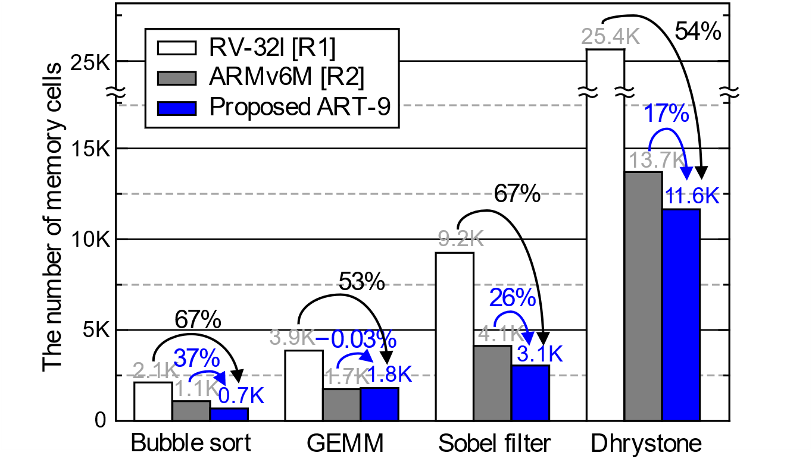
Simulation Results
Benchmark evaluations
Utilizing the proposed comiling framework
RV-32I (32b ISA), ARMv6M (16b ISA)
Fig.21. Required memory size for four benchmark programs
[R1] https://riscv.org/specifications/
[R2] J. Yiu et al., “The Definitive Guide to ARM
Cortex-M0 and Cortex-M0+ Processors”, 2015
Notes:
First simulation results are benchmark evaluations. We firstly designed ternary bubble-sort, general matrix multiplication (GEMM), sobel filter.
In addition, for the first time, a dhrystone benchmark is also described with the ternary instructions by converting the existing dhrystone code of the RV-32I ISA.
By using the proposed compiling framework, we can count the required number of memory cells for benchmark programs.
Although we developed a simple 24 9-trit instructions,
it is clear that the proposed ART-9 processor requires a much smaller memory size
when compare to the commercial 32b and 16b binary processors.

Slide 38
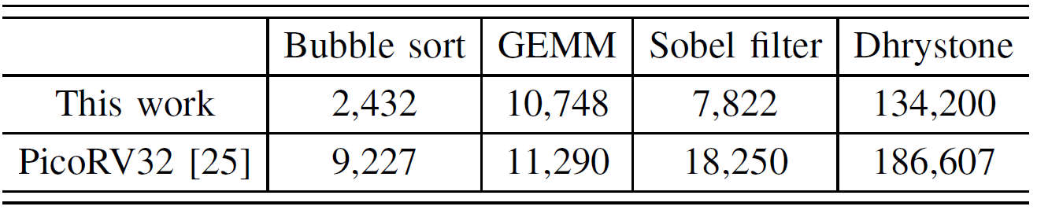
Simulation Results
Benchmark evaluations
In terms of processing cycles,
Comparison with Light-weight processors using RV-32IM [25]
Fast processing
[R1]
[R1] https://github.com/cliffordwolf/picorv32
Notes:
In terms of the required processing cycles,
the proposed 5-stage ternary processor takes smaller cycles processing benchmarks,
Compared with the recent light-weight RISC-based processor,PicoRV32.

Slide 39
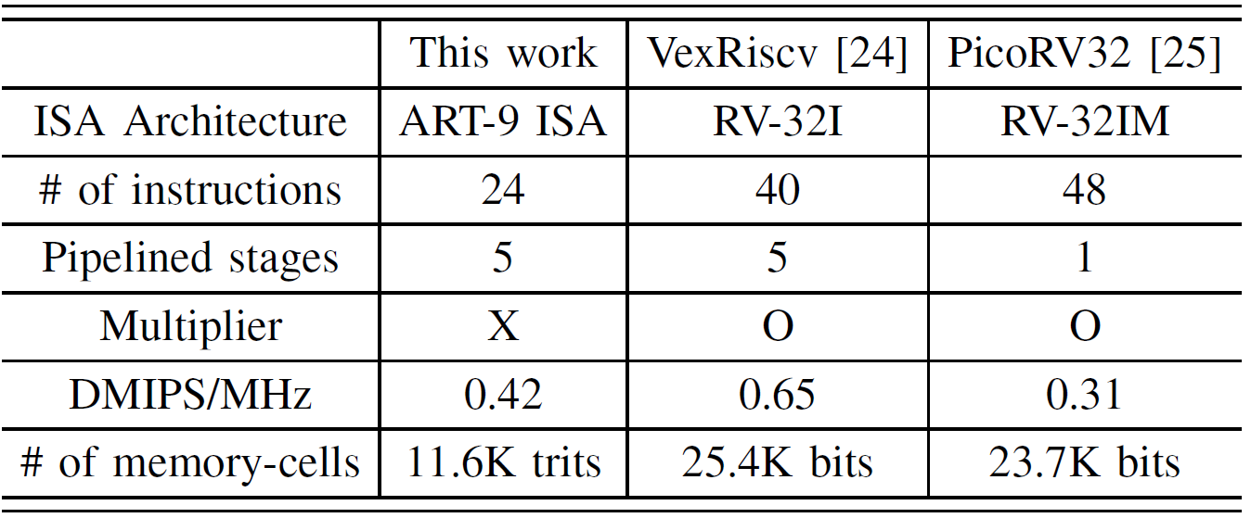
Simulation Results
Benchmark evaluations
Dhrystone benchmark
Comparison with Light-weight processors using RV-32I(M) [24], [25]
[R1]
[R2]
[R1] https://github.com/SpinalHDL/VexRiscv
[R2] https://github.com/cliffordwolf/picorv32
Notes:
For dhrystone benchmark, our proposed work still provide comparable processing speed as well as the optimized memory-cell counts.

Slide 40
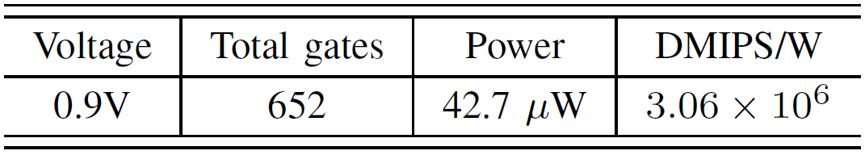
Simulation Results
Hardware-level evaluation
32nm CNTFET ternary models
Gate-level hardware cost
Even superior to the neat-threshold ARM Cortex-M3 [R1]
Fig.22. Proposed gate-level analyzer
[R1] R. G. Dreslinski et al., IEEE Micro, 2013
Notes:
Based on the proposed hardware-level evaluation framework, the proposed ART-9 core is implemented in 32nm CNTFET without considering the parasitic capacitance.
The datapath of ART-9 core only required 652 standard ternary gates, consuming 42.7 uW.
Its DMIPS/W also is even superior to the recent near-threshold ARM cortex-M3.

Slide 41
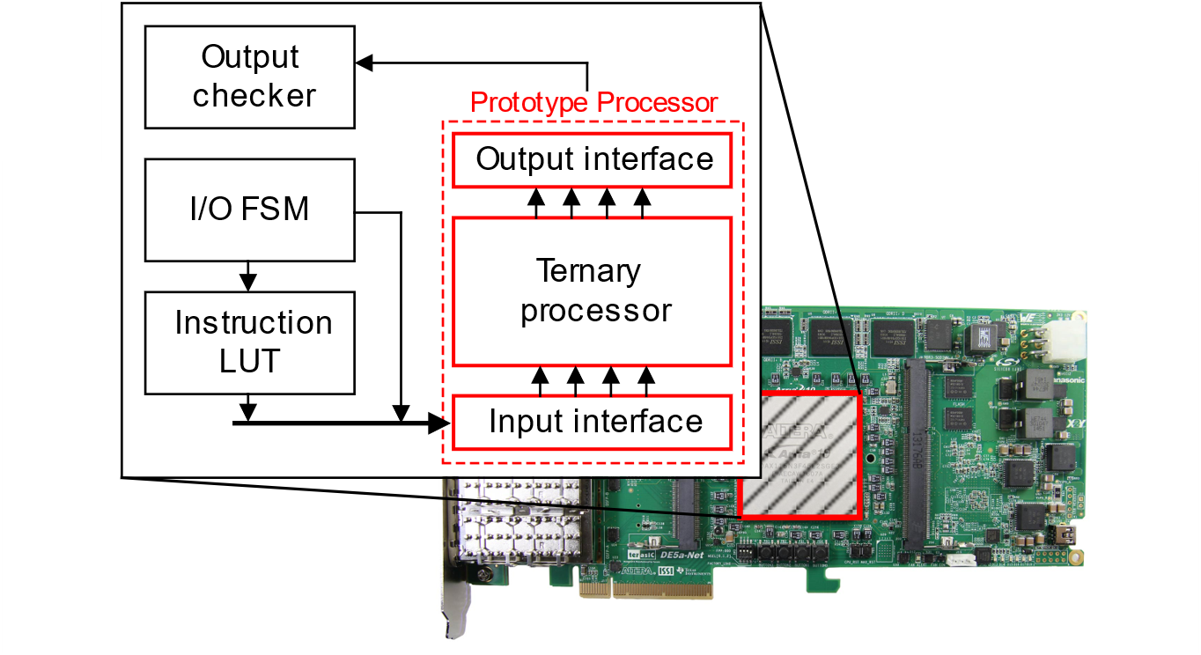
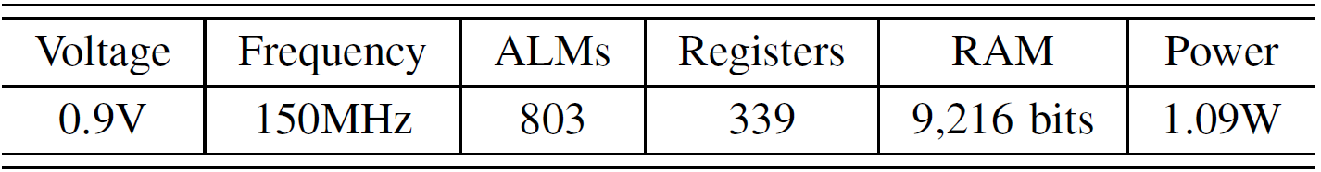
Simulation Results
Hardware-level evaluation
FPGA-based platfrom
2b-encoded ternary gates
Fig.23. FPGA-based evaluation platform
Notes:
In addition, on the FPGA-based platform, we evaluate hardware-performance by using 2b-encoded ternary gates.
Fig. 23 shows the detailed FPGA-based verification environment.
The implemented processor operates at 150 MHz in 0.9 V.
Finally, the proposed ART-9 processor achieves 57.9 DMIPS/W by consuming only 1.09W.
As a result, the proposed frameworks successfully make the ternary-based processor from emerging tarnsistors, which provide extreme-low-power computing.

Slide 42
Outline
Introduction
Ternary number systems and operators
Proposed frameworks for ternary processors
Proposed ART-9 core design
Simulation results
Conclusion
Notes:
Finally, we summarize our works in this conclusion.

Slide 43
Conclusion
There are many transistor-level works for ternary circuits.
However, only few works have studied ternary processors.
In this paper,
We firstly proposed software-and hardware-level frameworks to design ternary processors.
We also proposed advanced RISC-based ternary 9-trit (ART-9) processor, which is designed with ART-9 ISA and pipelined architecture.
We finally evaluate the proposed ART-9 core by using the proposed frameworks.
Notes:
Recently, ternary circuits are getting attention in high-performance implementation.
But, there are only few ternary-related works in processor or system-level.
In this paper, to design efficient ternary processor, we proposed a new software- and hardware-level frameworks.
We also proposed advanced RISC-based ternary 9-trit processor.
And then, evaluate the proposed ART-9 core by using the proposed frameworks with various benchmarks and emerging technologies.
Finally, our work would offer attractive design methods for ternary processor.

Slide 44
Design and Evaluation Frameworks for Advanced RISC-based Ternary Processor
Thank you
Notes:
My presentation is over. Thank you for listening.

